Slide 1




PRESENTATION 2026
Project Title StatuteEasy — Real-Time Law Translation & Simplification Tool
Faculty-Dr. Chaitra V Email-chaitrablore@gmail.com
Mentor-Umamaheshwari

Slide 2

Outline
Abstract of the Project
Problem Statement
Proposed Solution
System Architecture
Live Demo of the Project
Embedded Video of Project
Conclusion
Future Scope

Slide 3
Abstract
Legal jargon (legalese) in statutes makes them incomprehensible to citizens.
This project aims to develop AI tool for simplification and multilingual translation of legislation. The initial scope of the study is to simplify one central legislation relating to women's protection and translate into one regional language by building a legal chatbot using co-pilot studio.
The expected outcome is the creation of a functional Law Simplifier Bot which improves legal literacy of women and accessibility, but will not be a substitute for professional legal advice.

Slide 4

Problem Statement
The project addresses the inaccessibility of laws in India due to complex legal language (“legalese”), which makes it difficult for common citizens, especially women in low-literacy states to understand, limiting awareness and access of rights.
Even educated women often struggle to comprehend these laws, as the language remains highly technical
Existing resources provide translations but retain jargon and lack user-friendly explanations.

Slide 5
Proposed Solution
The project proposes to create a multiltingual legal chatbot using Microsoft Copilot Studio to simplify and translate central legislations relating to women protection.
The methodology involves selecting key provisions of the law, rewriting them in simple language, and translating them into one regional language. This content is then organized into a corpus and used to build a chatbot that can answer common legal questions in the form of conversations.
Key benefits include enhanced legal awareness among women, providing accessibility for non-English speaking women and scalable architecture that can be extended to more laws and languages, making it a useful and impactful legal-tech innovation.

Slide 6
System Architecture
Data Input / Source
Processing / Analysis
India Code website is a repository of all Central Acts of the Parliament, can be downloaded in pdf ( https://www.indiacode.nic.in/)
Human intervention is required to check the accuracy of the simplified and translated output so that the essence of the law is not diluted, Validated outputs using legal experts or para-legal reviewers.
AI / Tool Integration
Output / Dashboard
Excel is used to organize the sections of the law, and translations in tabular form & Microsoft Copilot Studio is used to create the chatbot that interacts with the users
A chatbot interface that answers legal questions with respect to POSH Act and provides explanations of laws in Kannada language as well.

Slide 7
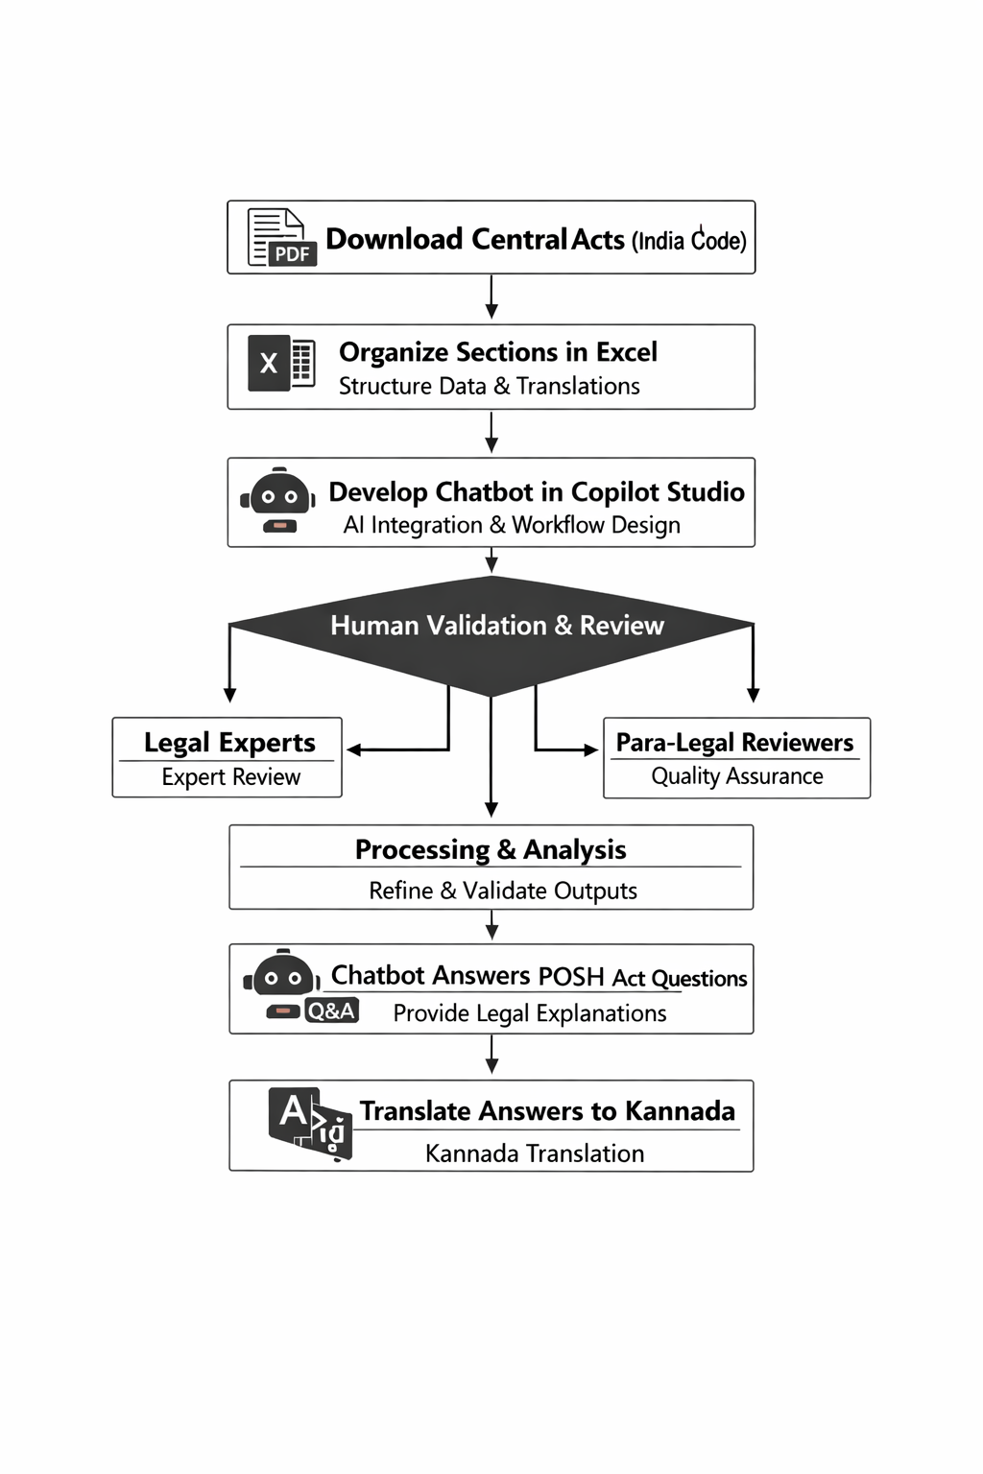

Slide 8
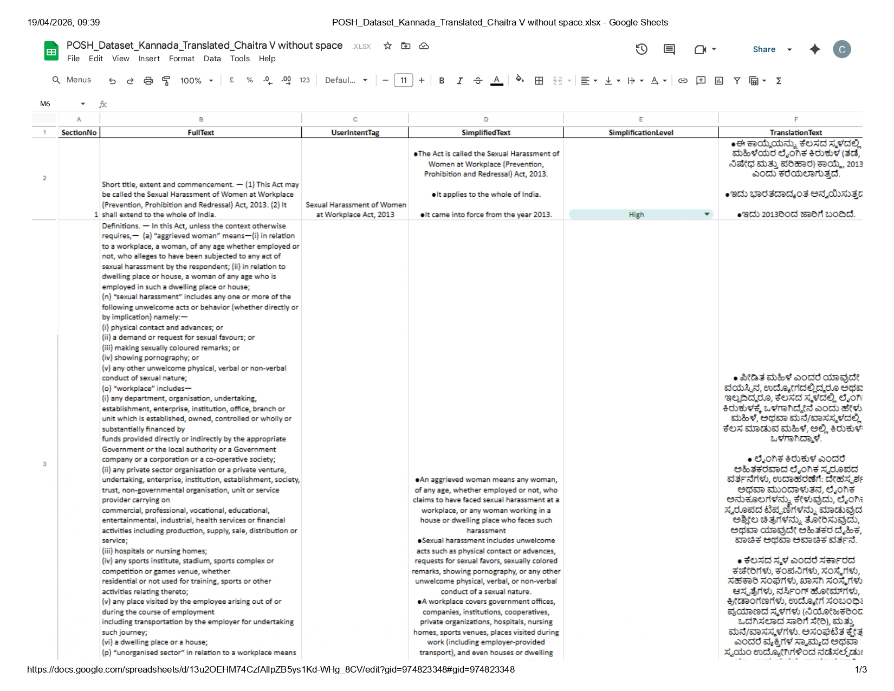
Data Set

Slide 9
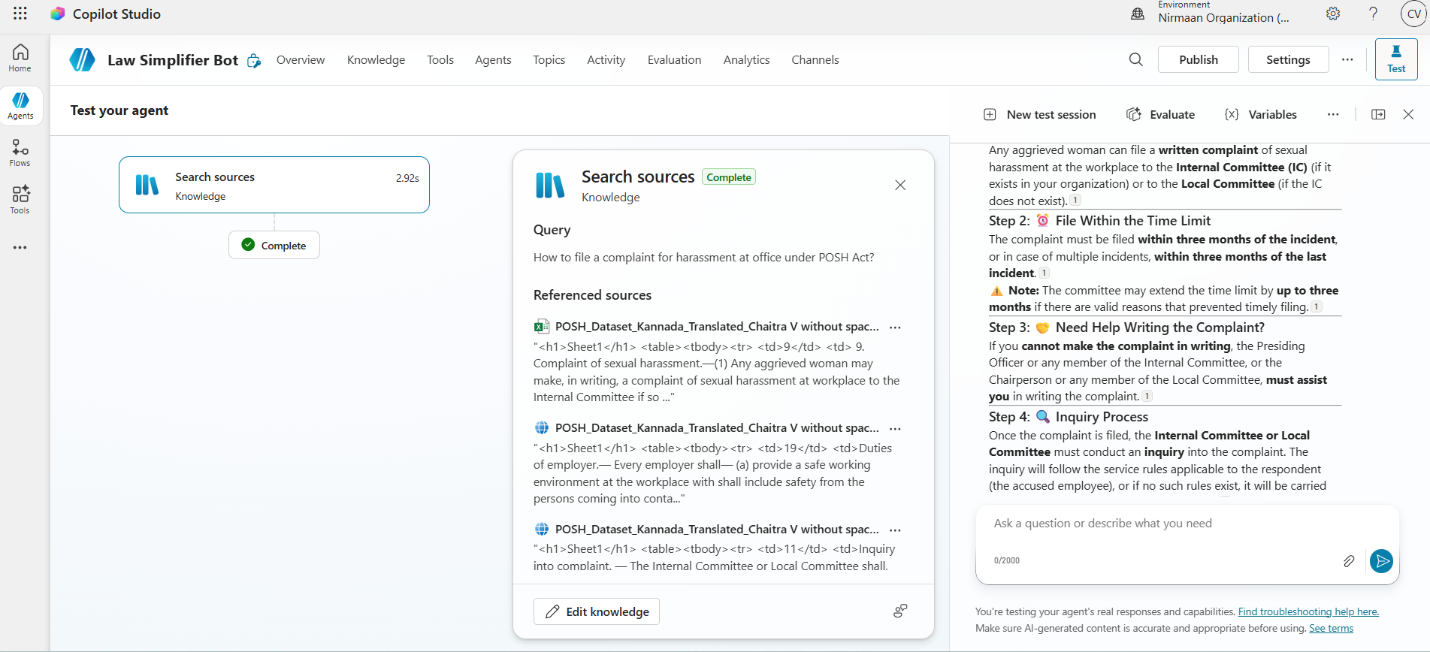
Live Demo of Project
Here's the list of some demo screenshots / features of the project:
Demo 1
Shows how the chatbot answers basic questions on POSH Act in simple language .

Slide 10
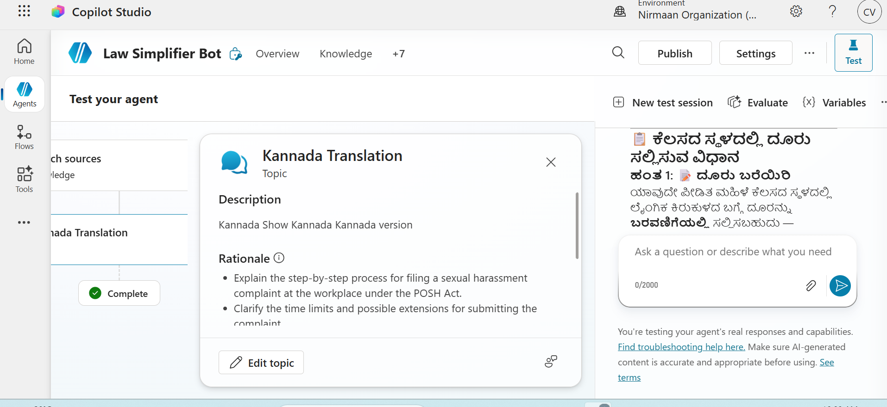
Demo 2
Shows how the chatbot answers basic questions on POSH Act in Kannada language

Slide 11
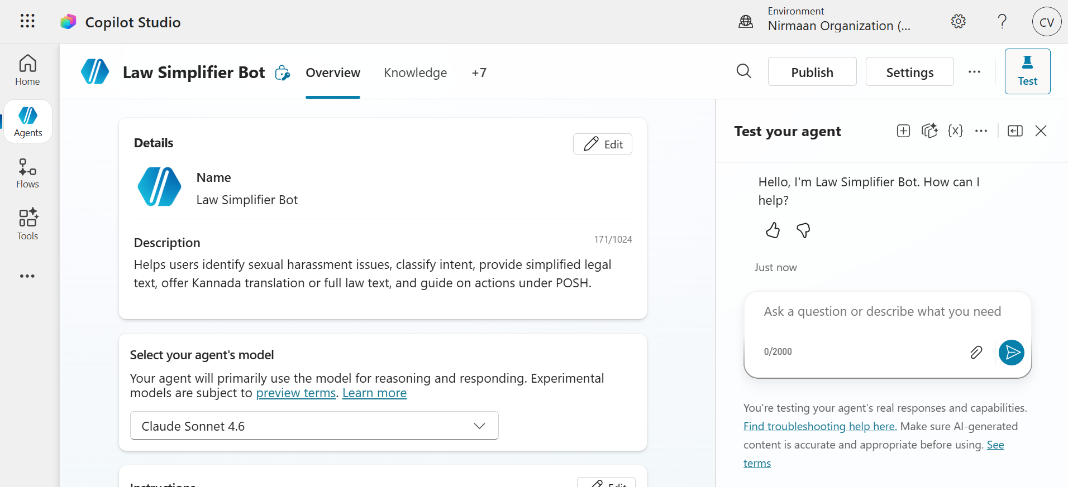
Demo 3
Chatbot homepage (pre-launch)

Slide 12
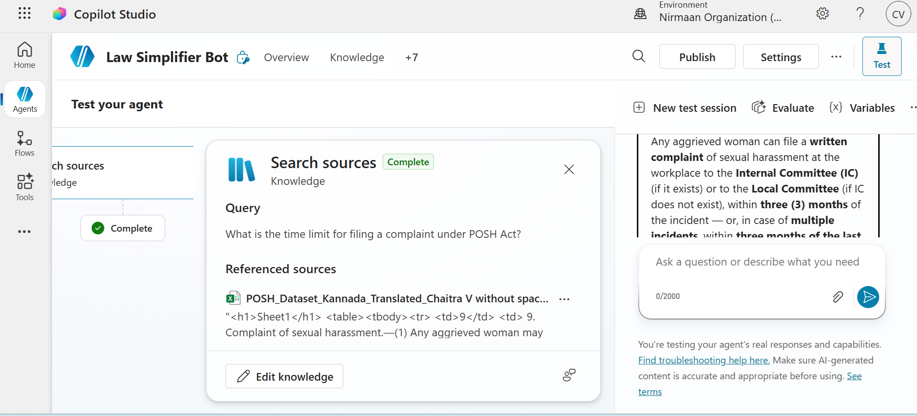
Evaluation
Bot response
8/10 clear and detailed response, but sometimes repeats the answers though answered in previous messages
CONCLUSION

Slide 13
Video of Project Demo
https://drive.google.com/file/d/1eq0DXNJbG7IZ0TX06VOSuf5CHsAFIBks/view?usp=sharing
▶
https://drive.google.com/file/d/1eq0DXNJbG7IZ0TX06VOSuf5CHsAFIBks/view?usp=sharing

Slide 14
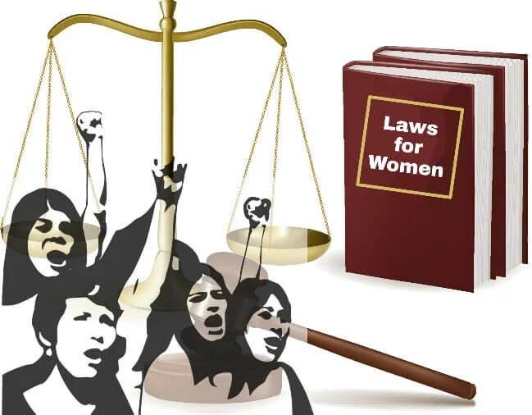
Conclusion
This project successfully developed a multilingual legal chatbot using Microsoft Copilot Studio to simplify and translate key provisions of The Sexual Harassment of Women at Workplace (Prevention, Prohibition and Redressal) Act, 2013, known as the POSH Act, into simplified English & accessible Kannada language.
CONCLUSION

Slide 15

Future Scope
The project can be extended to more laws and languages, making it a useful and impactful legal-tech innovation, targeting states with low literacy and limited legal aid access.

Slide 16
Thank You
AICW Fellowship | Student Project Presentation 2026
LinkedIn | Edunet Foundation

